Slide 2

Quick facts :
IPL is a professional Twenty20 cricket league in India contested during April and May of every year by teams representing Indian Cities.
Founded by BCCI and it is now the most attended cricket
league in the world and ranks sixth among all sports league.
In 2010, the IPL became the first sporting event in the world to be broadcasted live on YouTube.

Slide 3
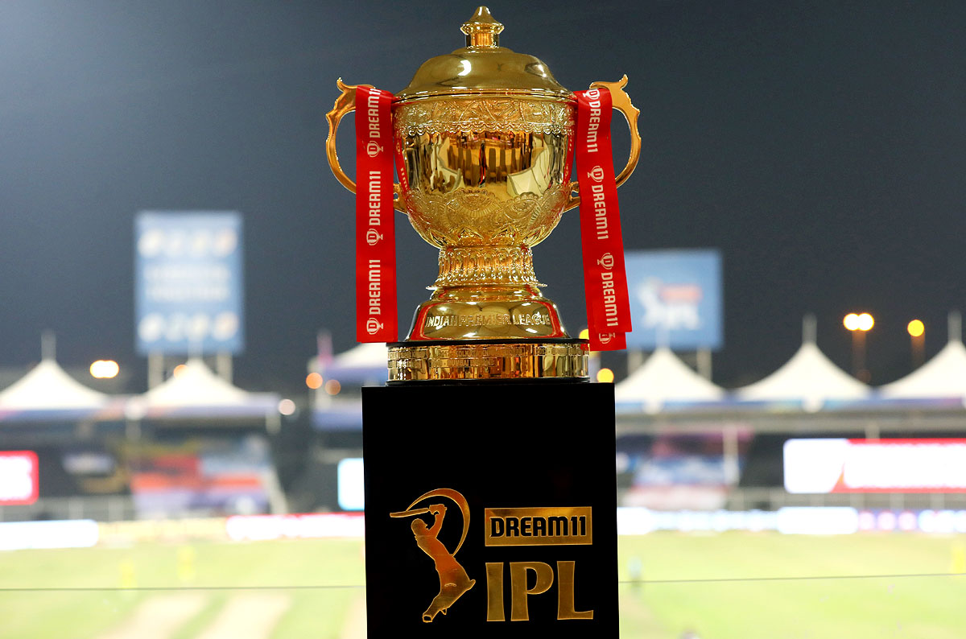
Brief Overview of Indian Premier League (IPL)
Data Consist Of :
Data of 9 IPL Seasons from 2008 to 2022
Ball by Ball details of 577 matches
Match details
Player details
Season wise best performers

Slide 4
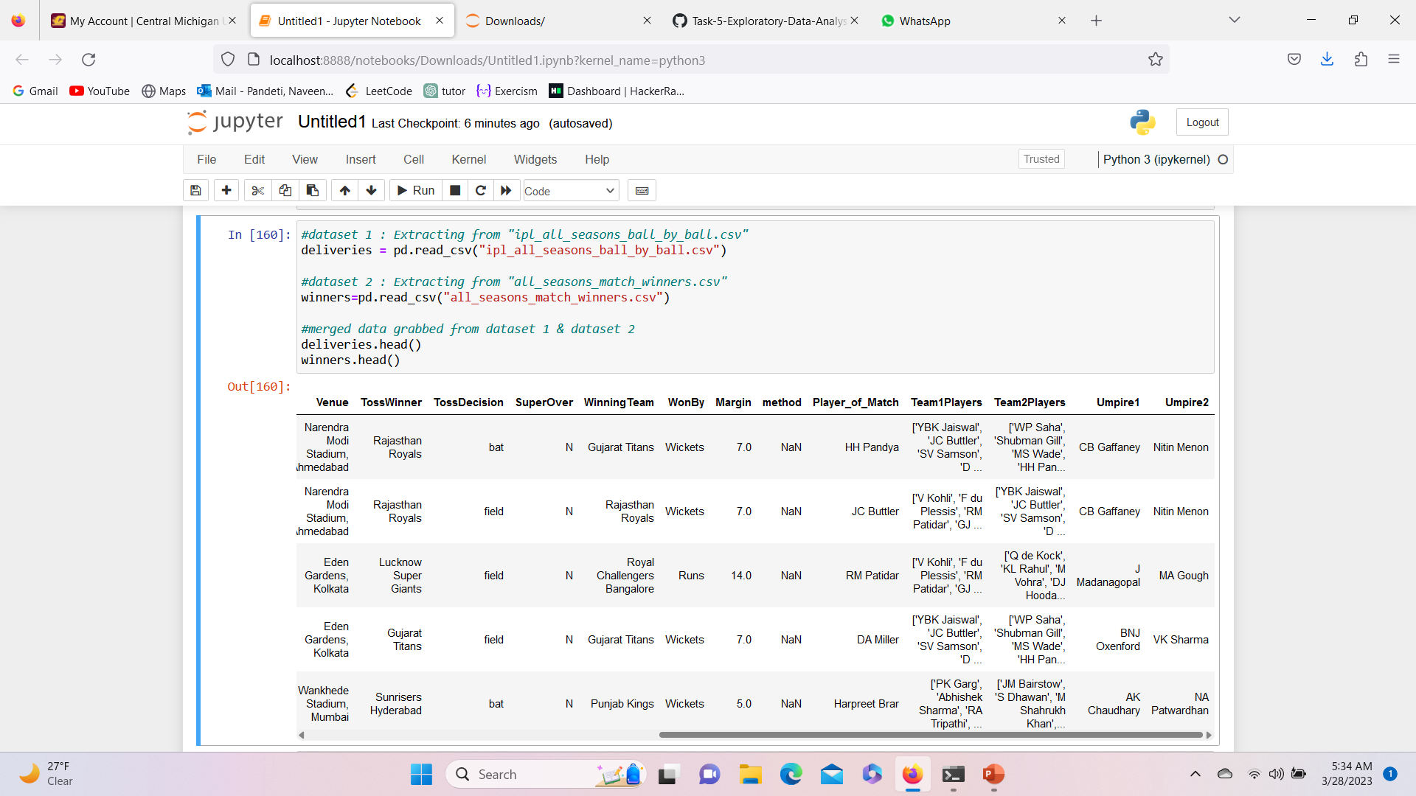
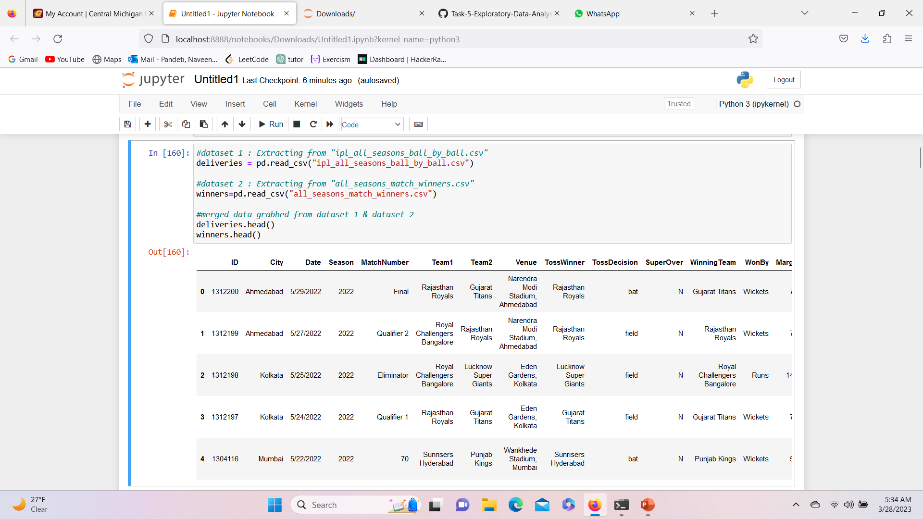
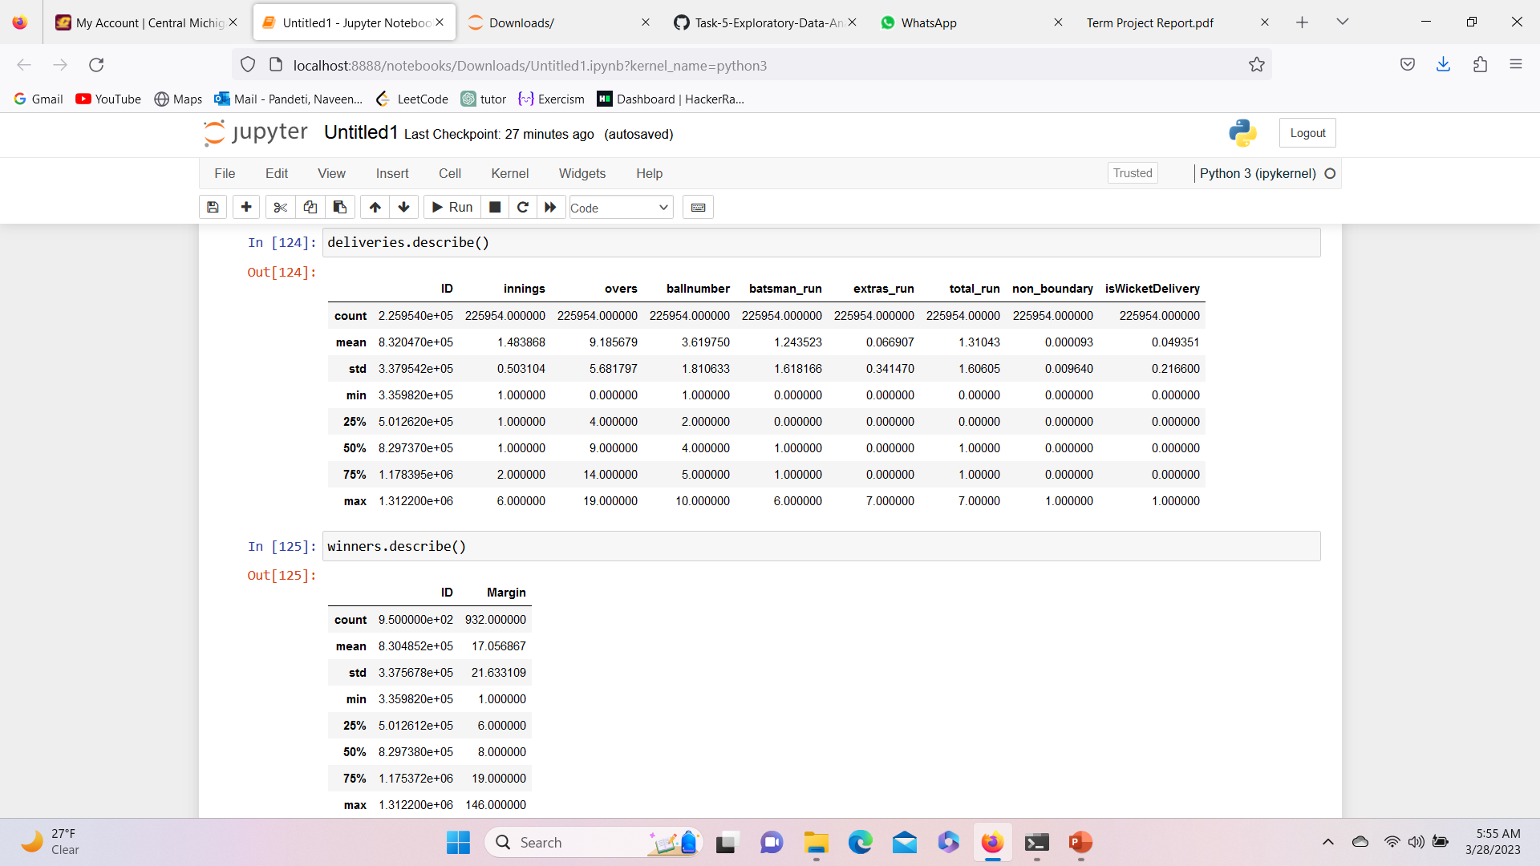
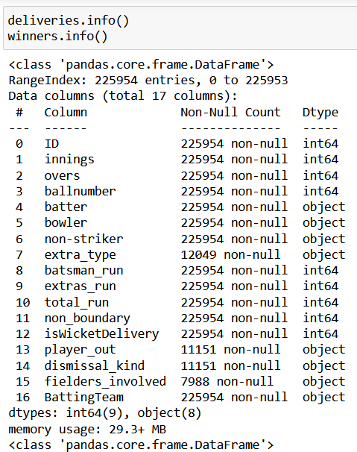
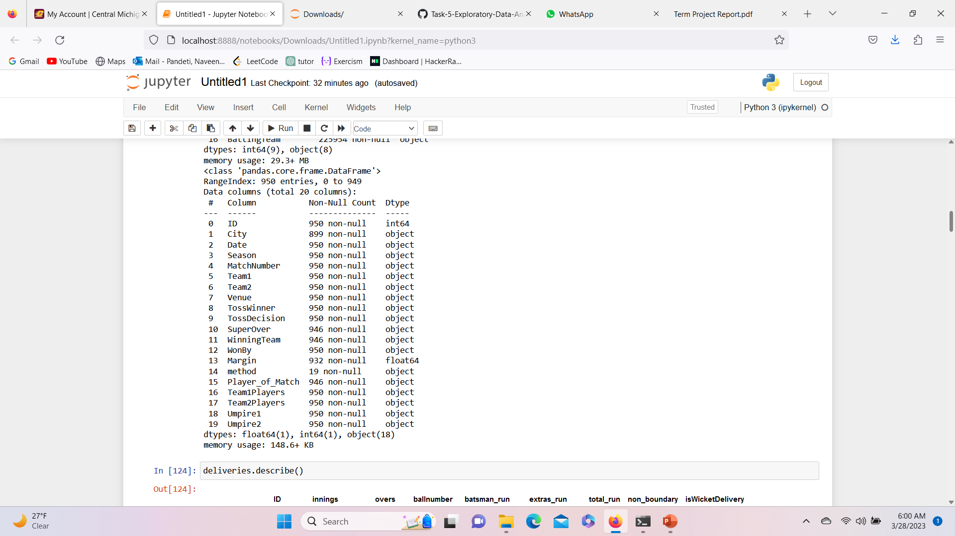
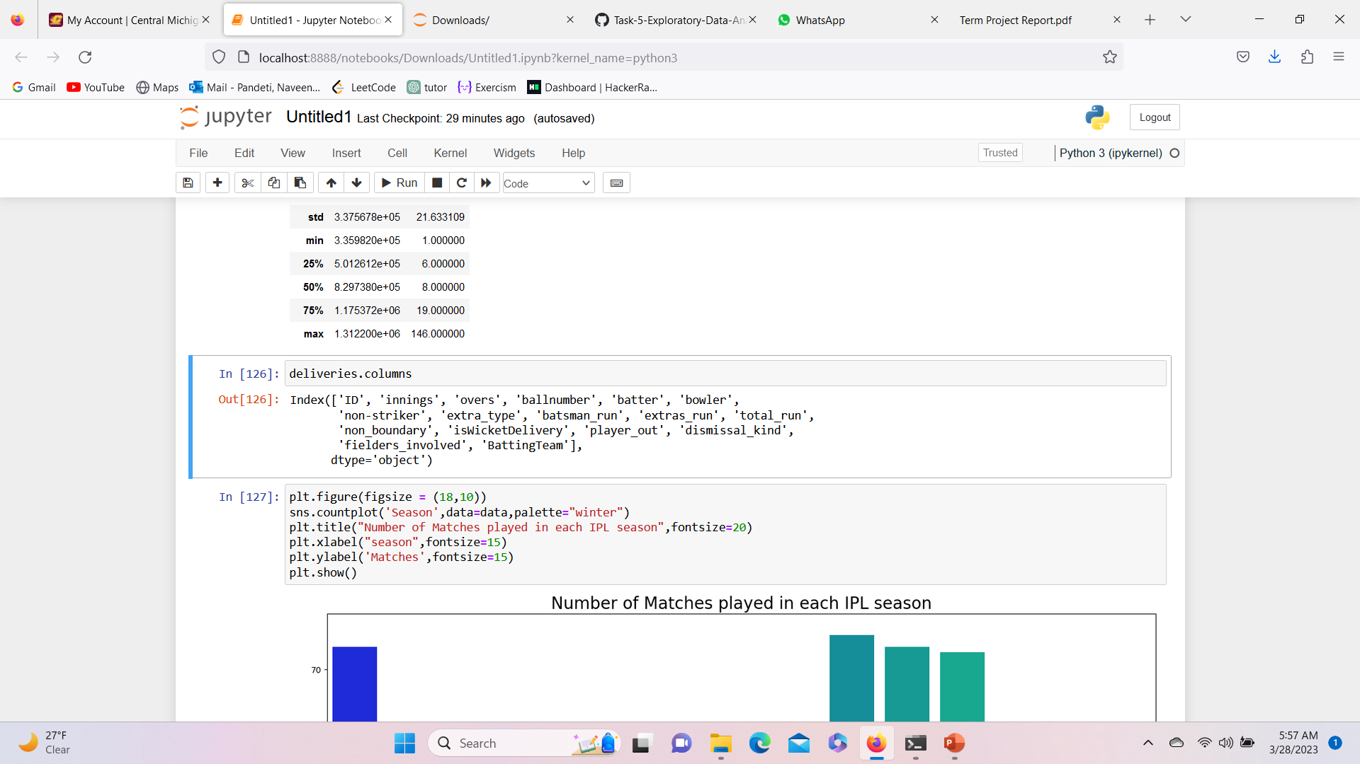
Data Cleaning & EDA :
Here we have merged the two data sets and performed the basic operations on the datasets to display Head , Tail, info & describe along with the number of rows .
Snippets & Outputs :

Slide 5
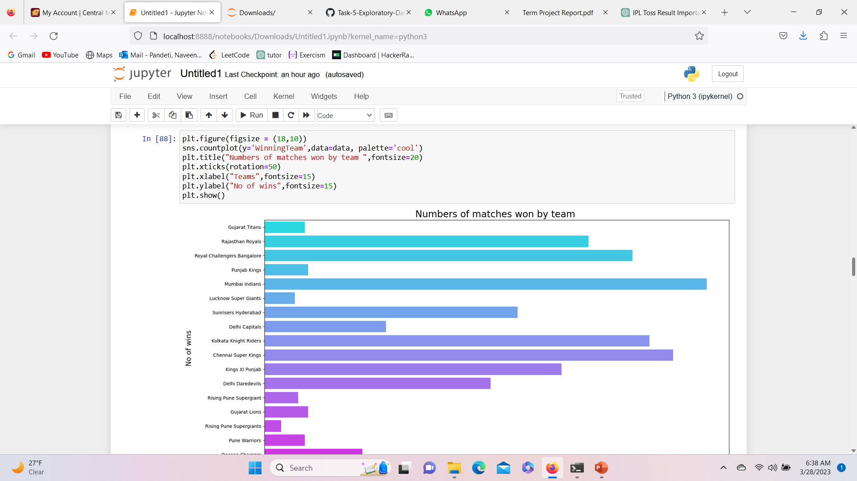
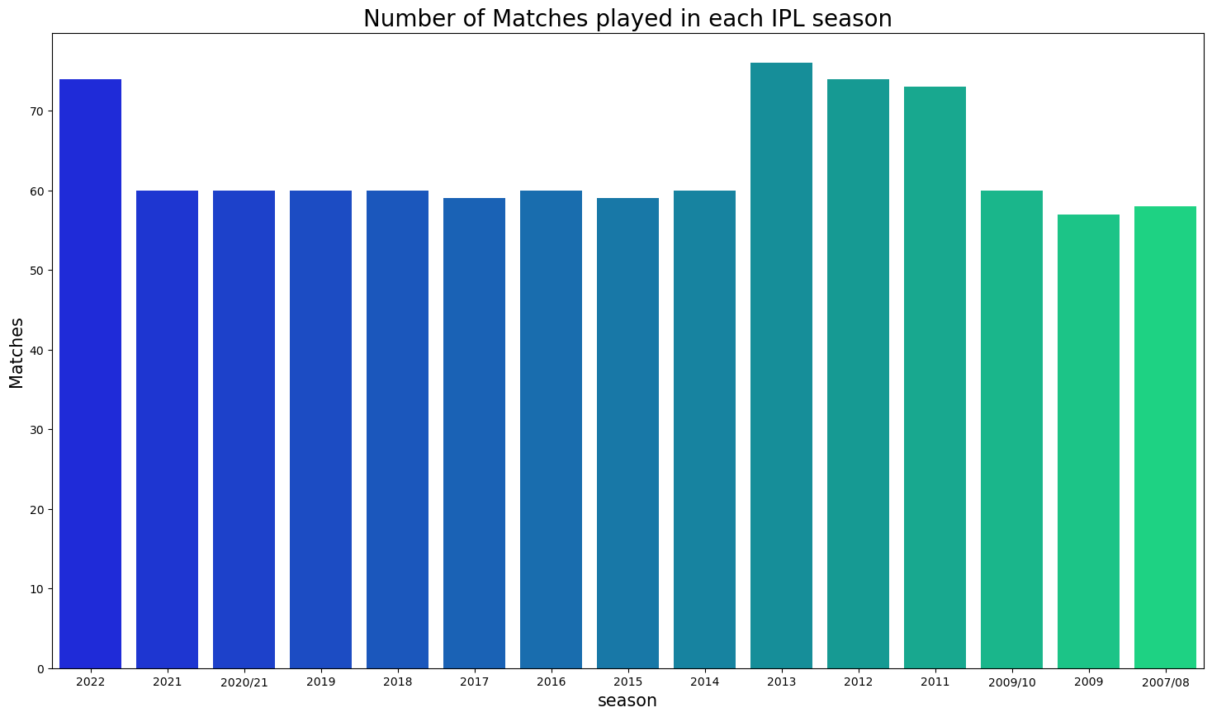
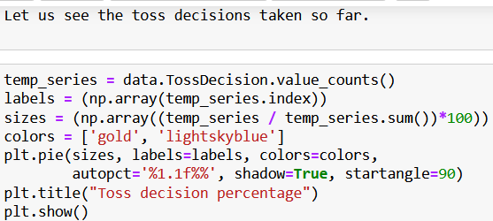
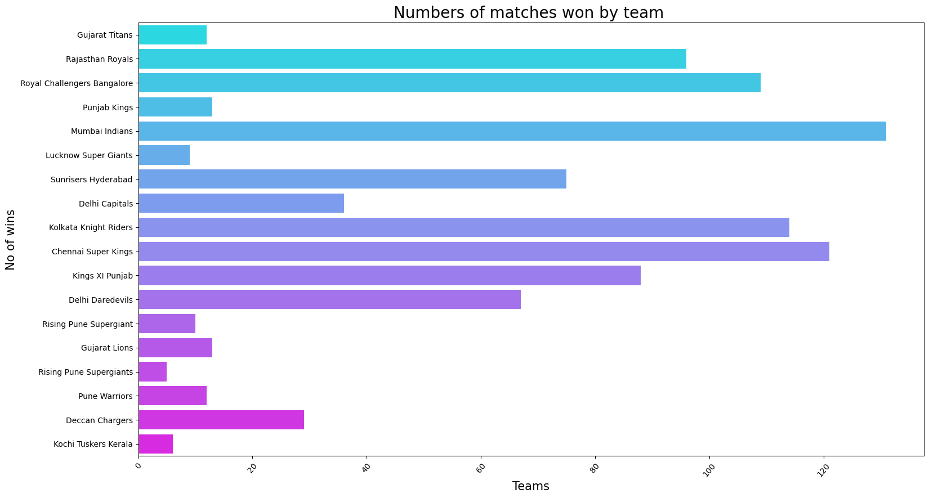
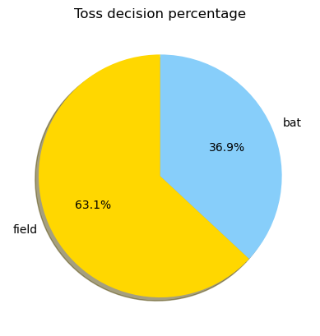
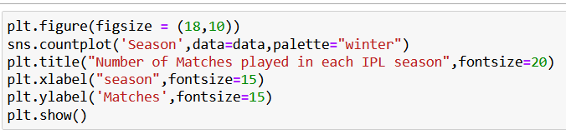
Few Hypothesis on EDA - Web Scrapping
Eda web scrapping on finding the total number of matched played each season .
TOSS RESULT : How is Toss more important ?
Total number of matches won by a team so far:
The toss result in the Indian Premier League (IPL) is crucial as it can have a significant impact on the outcome of the match. The most common use of the toss result is for the winning captain to decide whether to bat or bowl first.
This tells more number of matches played in the year of 2013.
Overall, the number of matches won by a team is an essential factor in determining their position in the IPL standings, their chances of qualifying for the playoffs, and their overall performance and confidence.

Slide 6
Merging the Datasets :
What is the use of merging these data sets ?
Merging datasets can be useful in IPL EDA (Exploratory Data Analysis) to analyse and identify patterns in the data. For example, you can merge the player's performance data with team data to identify the performance of players in each team.
Some of the use cases of merging two datasets in IPL EDA are:
Analyzing the performance of players in different teams: By merging the player performance data with team data, we can analyze how a player performs in different teams. We can also compare the performance of players in different teams based on different criteria, such as the number of runs, wickets, etc.
Analyzing the impact of toss on team's performance: By merging the match data with the toss data, we can analyze how the toss result impacts the performance of the teams. We can identify patterns in the data to see whether teams that win the toss have a higher chance of winning the match.
Analyzing the impact of weather conditions on match outcomes: By merging the match data with the weather data, we can analyze how different weather conditions impact the match outcomes. We can identify patterns in the data to see whether certain weather conditions favor certain teams or whether they lead to more high-scoring or low-scoring matches.
Overall, merging two datasets in IPL EDA can help us to get more insights into the data, identify patterns, and make more informed decisions based on the analysis.

Slide 7
Before merging & After merging of datasets
Initial count of Dataset 1
ROWS : 225595
COLUMNS : 17
Merged Dataset :
columns = 36
Rows = 225595
Initial count of Dataset 2
ROWS : 951
COLUMNS : 20
Refferences :
https://www.espncricinfo.com/ci/engine/series/313494.html?view=records
https://www.kaggle.com/datasets/rajsengo/indian-premier-league-ipl-all-seasons?select=points_table.csv

Slide 8
Conclusion :
In conclusion, merging datasets can be a useful technique in IPL EDA to gain more insights and analyze the data more effectively.
By combining two or more datasets, we can identify patterns and relationships that may not be evident when analyzing the data separately.
In the case of IPL datasets, merging different datasets such as player performance data, team data, match data, and toss data can provide a better understanding of the game and help us identify trends and patterns in the data.
By analyzing the merged data, we can draw meaningful insights that can help teams make more informed decisions on team selection, strategy, and game planning.
For instance, we can analyze the performance of players in different teams, identify the impact of toss on team performance, and evaluate the impact of weather conditions on match outcomes.
Therefore, merging datasets is an essential technique for IPL EDA, as it helps us to better understand the data, identify insights, and make more informed decisions.

